Slide 1
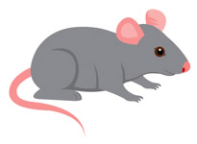
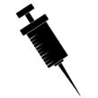
500 mice
375 transgenic mice – 28 days infusion with Ang II
125 wild type mice
125-IL-18 KO
125-IL-18 receptor KO
125-IL-18/R
Immunohistochemistry

Slide 2
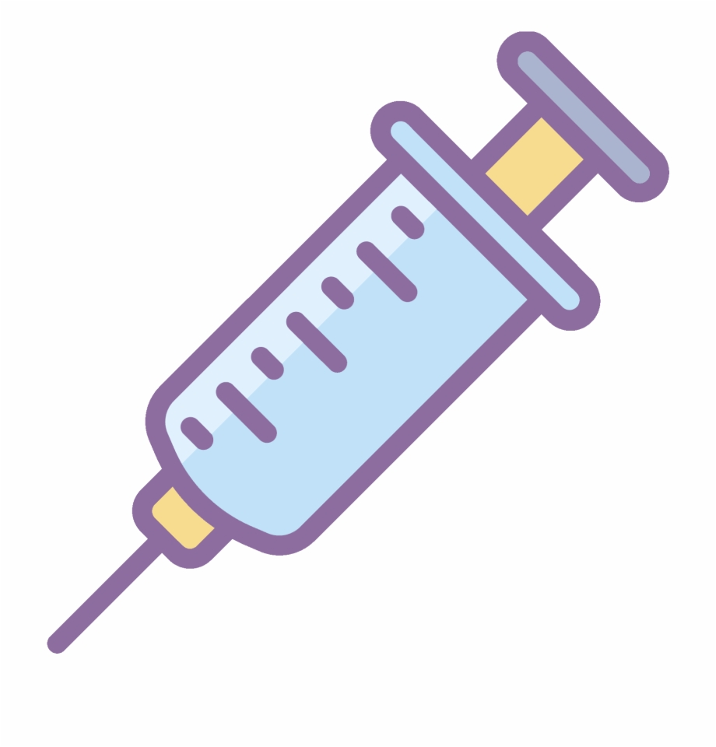
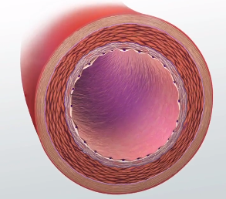
Timeline
- 28 days infusion with AAA
- Saline treatment
30 mice
Day 1
Infusion with Ang-II or saline
Day 28
10 wild type
mice
10 wild type mice
10 IL-18 KO transgenic mice
Post in vivo experiment examination
Day 36
Harvesting of AA and freezing in Tissue-Tek® O.C.T
Immunofluorescence

Slide 3
Inject Ang II
Vasoconstriction
Decrease GFR – Increase water retention
Increases thirst
Increased blood pressure
AAA formation in mice that are prone to getting it

